Slide 1
Attribute based visualization

Slide 2
Icons
Idea: Map each instance to an icon Icon characteristics, or the icon itself, map attribute values
Two attributes can be mapped to positions in the plane Other attributes can be mapped to color, size, shape, or specific characteristics related to icons
Popular techniques: Faces de Chernoff Stick Figures Star Glyphs

Slide 3
Faces de Chernoff
Uses humanized faces to represent instances of the collection Two of the dimensions are mapped to the position of the faces The rest of the dimensions are mapped to characteristics of the component elements of the face Eyes
Nose Mouth
etc.

Slide 4
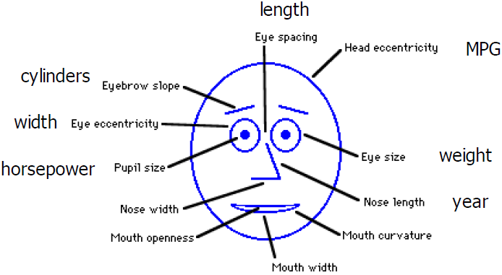
Faces de Chernoff
Retirado de [5]

Slide 5
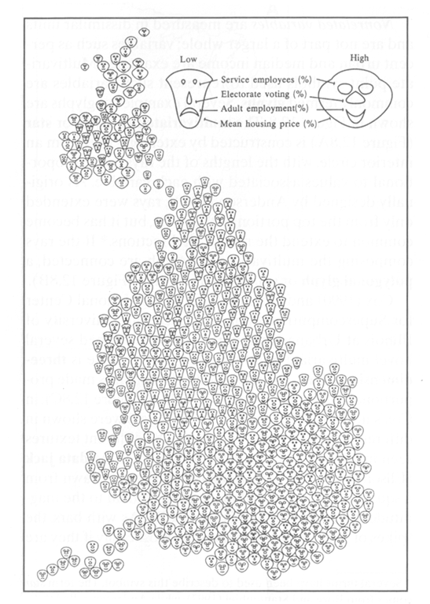
Faces de Chernoff
https://www.mat.ucsb.edu/~g.legrady/academic/courses/09w259/proj3/andres_applet/

Slide 6
Stick Figures
Icon: figure in stick style Similar to chernoff's faces method
Difference: icon format Remaining attributes are mapped at icon angles and lengths If the distribution of the data is relatively dense with respect to dimensions, the layout will highlight texture patterns that reflect the characteristics of the data: pre-attentive perception

Slide 7
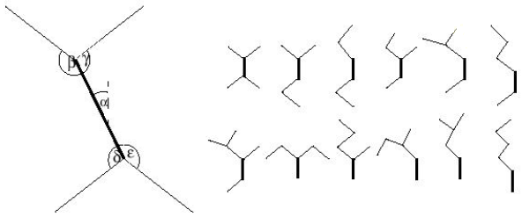
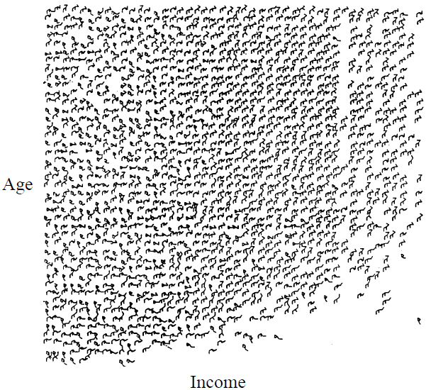
Stick Figures
Taken from [1]
Taken from [3]
Notes:
Five dimensional census data of 1980 US census.
X vs Y: Income and age
Attributes occupation, education, level, marital status, and sex: stick figures
Interesting is the clear shift in texture over the screen which indicates the functional dependency of the attributes from income and age

Slide 8
Star Glyphs
M-dimensional data is mapped in m radius from a point forming equal angles One glyph for each instance Radius length is proportional to the value of the corresponding dimension for the instance in question

Slide 9
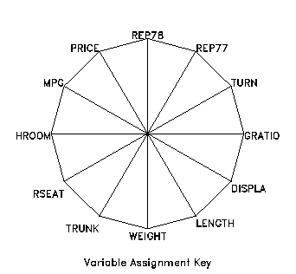
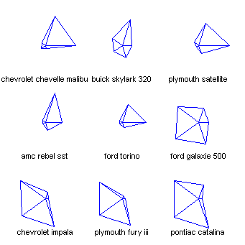
Star Glyphs
http://www.math.yorku.ca/SCS/sugi/sugi16-paper.html
https://eagereyes.org/blog/2008/linear-vs-quadratic-change

Slide 10
Hierarchies
Idea: Divide the m-dimensional space into subspaces presented hierarchically Popular techniques Dimensional stacking Treemap

Slide 11
Dimensional stacking
Position of the instances is defined by stacking each dimension, one within the other Observations Stacking order influences the final result Data does not have to be hierarchical

Slide 12
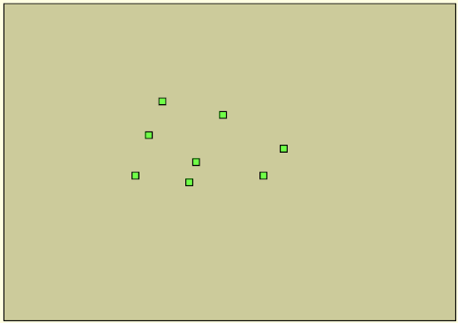
Dimensional stacking
Process (4-dimensional data) [6]

Slide 13
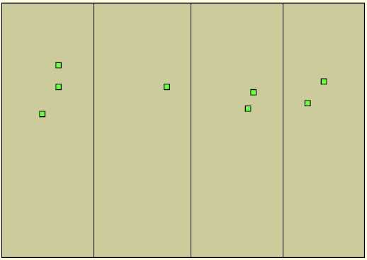
Dimensional stacking
Process (4-dimensional data) [6] Positioning according to attribute 1

Slide 14
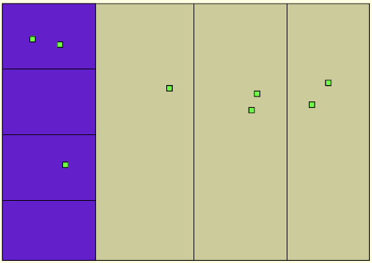
Dimensional stacking
Process (4-dimensional data) [6] Positioning according to attribute 2

Slide 15
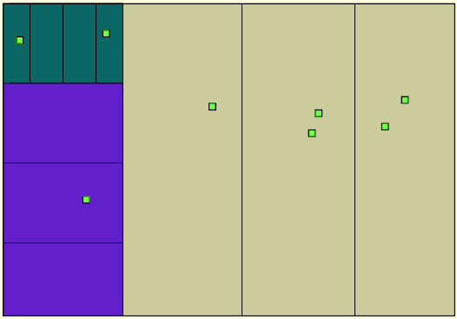
Dimensional stacking
Process (4-dimensional data) [6] Positioning according to attribute 3

Slide 16
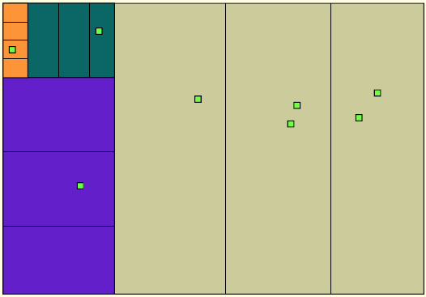
Dimensional stacking
Process (4-dimensional data) [6] Positioning according to attribute 4

Slide 17
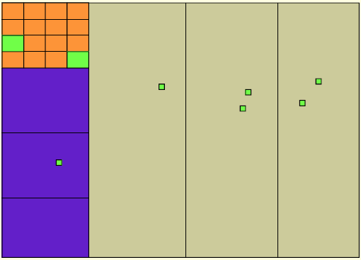
Dimensional stacking
Process (4-dimensional data) [6] Fixed blocks

Slide 18
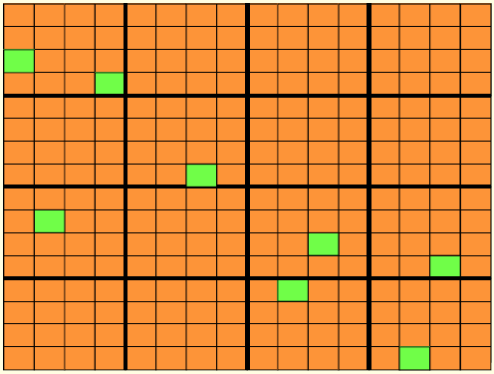
Dimensional stacking
Process (4-dimensional data) [6] Final result

Slide 19
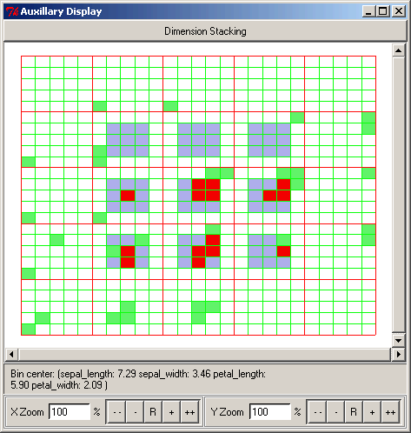
Dimensional stacking
Example: Iris set date [7]

Slide 20
Dimensional stacking
Observations [3] Unique attributes can have their values discretized at intervals Important attributes must be mapped at the outermost levels Particularly suitable for low cardinality ordinal attributes Cardinality means two things in databases. ... In this sense, cardinality means whether a relationship is one-to-one, many-to-one, or many-to-many.

Slide 21
Treemap
Partitioned view space in a set of rectangular areas representing a hierarchical structure Size of rectangular area proportional to the content of instances or group instances represented by the area Idea: most important information with greater prominence Result: Layouts with great use of the viewing space

Slide 22
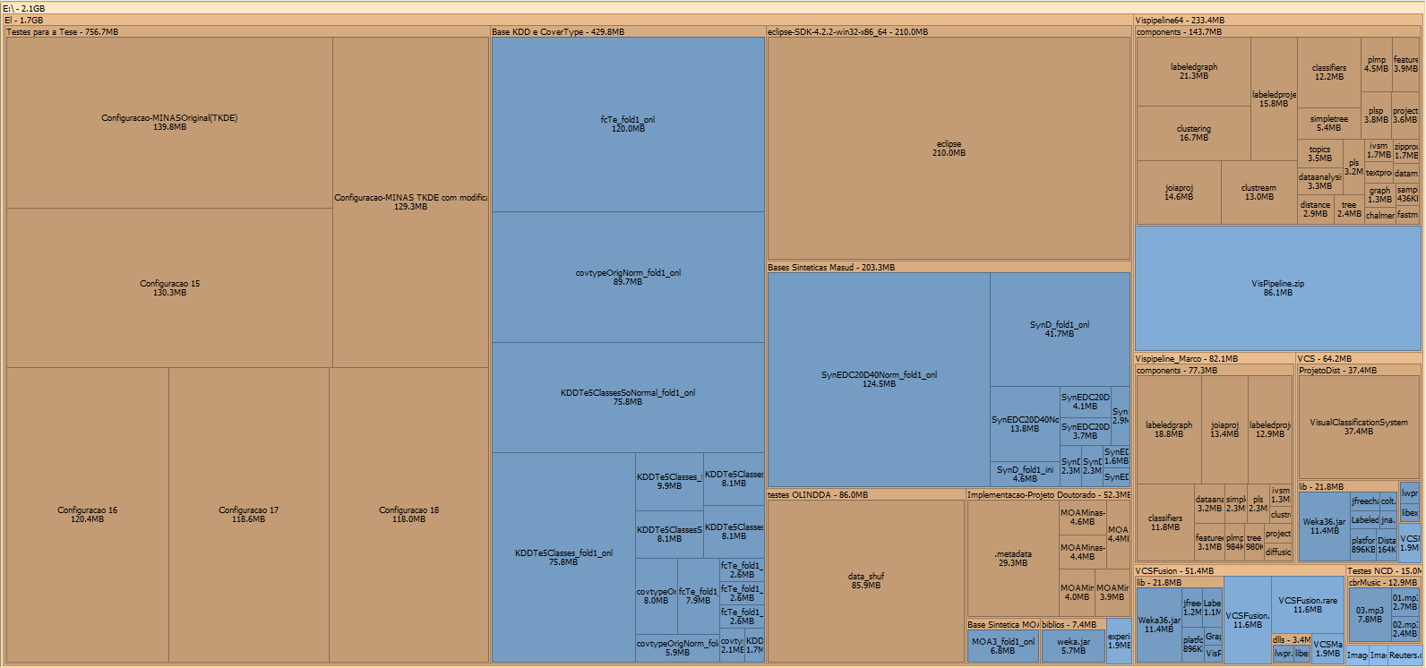
Treemap
Gerado por SpaceSniffer

Slide 23
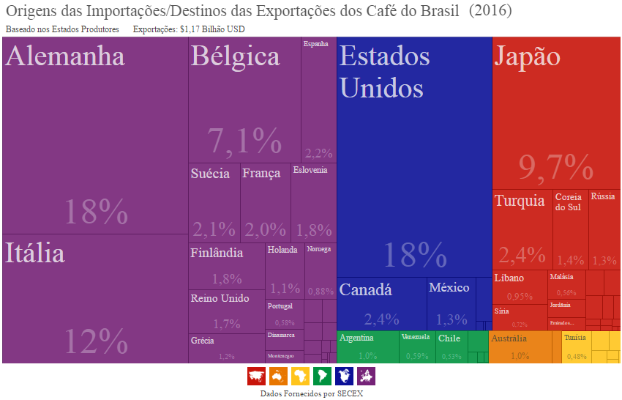
Treemap
DataViva

Slide 24
Attribute-based techniques
Limitations High dimensionality/large data data: cluttering Ordering attributes greatly influences layout

Slide 25
References
Keim, D., Kriegel, H., Visualization techniques for mining large databases: A comparison. IEEE Transactions on Knowledge and Data Engineering, v. 8, n. 6, p. 923 – 938, 1996.
Keim, D., Designing Pixel-Oriented Visualization Techniques: Theory and Applications. IEEE Transactions on Visualization and Computer Graphics, v. 6, n. 1, pp. 59-78, 2000.
Oliveira, M. C. F, Information Visualization Techniques, Computer Visualization course class notes, University of São Paulo - Campus São Carlos Kosara, R., Parallel Coordinates, disponível em https://eagereyes.org/techniques/parallel-coordinates

Slide 26
References
Stasko, J., Multivariate VisualRepresentations 1, notas de aula da disicplina de Information Visualization da Georgia Institute of Technology, disponível em http://www.cc.gatech.edu/~stasko/7450/
Yang, J., Information Visualization, information visualization class notes from the University of North Carolina at Charlotte (UNCC), available in http://webpages.uncc.edu/jyang13/infovis2010/MultiVis.pdf XmdvTool User's Manual, disponível em http://davis.wpi.edu/xmdv/docs/help_all.html
Keim, Daniel A. Pixel-oriented visualization techniques for exploring very large data bases., Journal of Computational and Graphical Statistics 5.1 (1996): 58-77.
https://web.wpi.edu/Pubs/ETD/Available/etd-012108-200050/unrestricted/walsht.pdf

